Slide 1
Internship search portal
Employer and Students are in constant need of each other. However, constant specialism towards each other increases the gap between them. We realized that this gap can be bridge by adding element of credibility and openness of Employer and Entity.

Slide 2
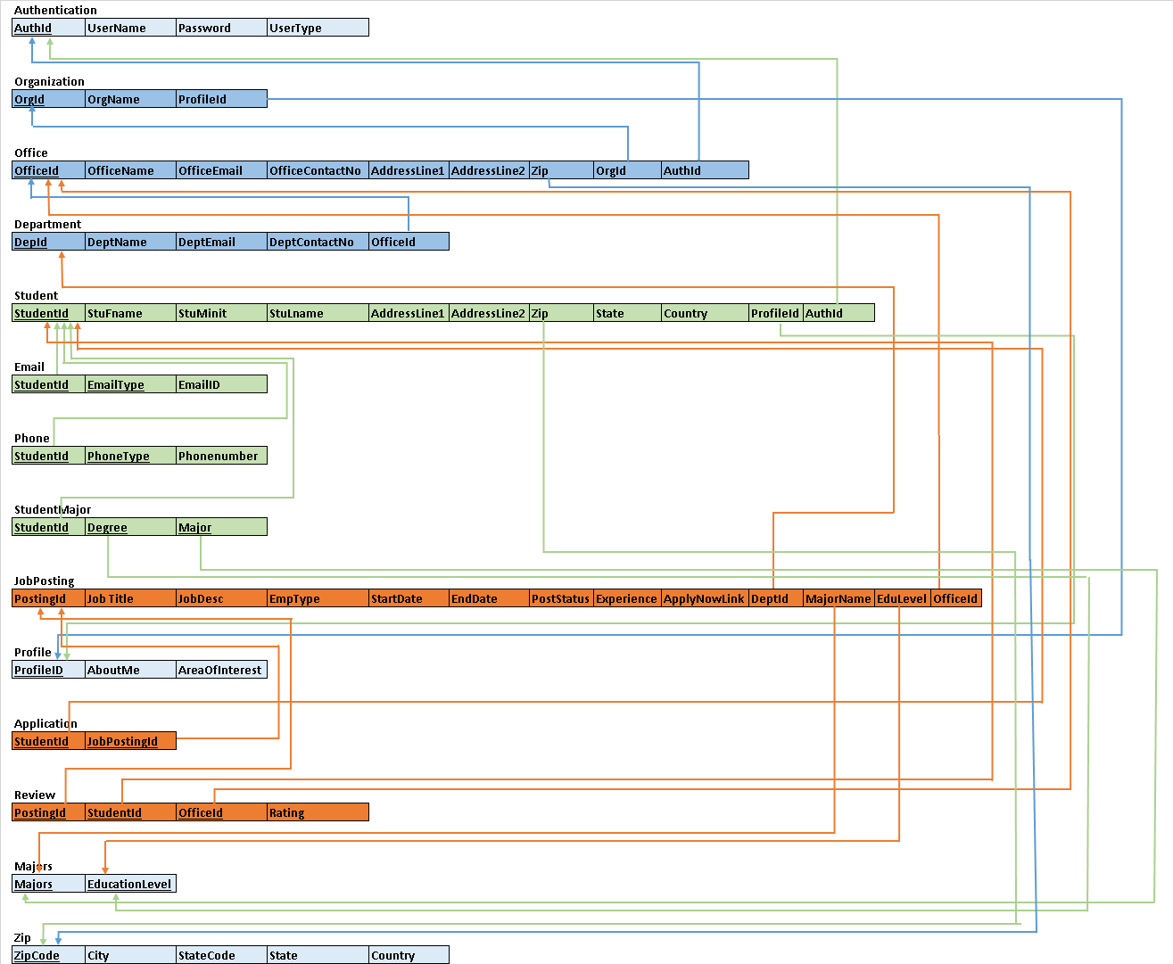
Semantic
And
relationship

Slide 3
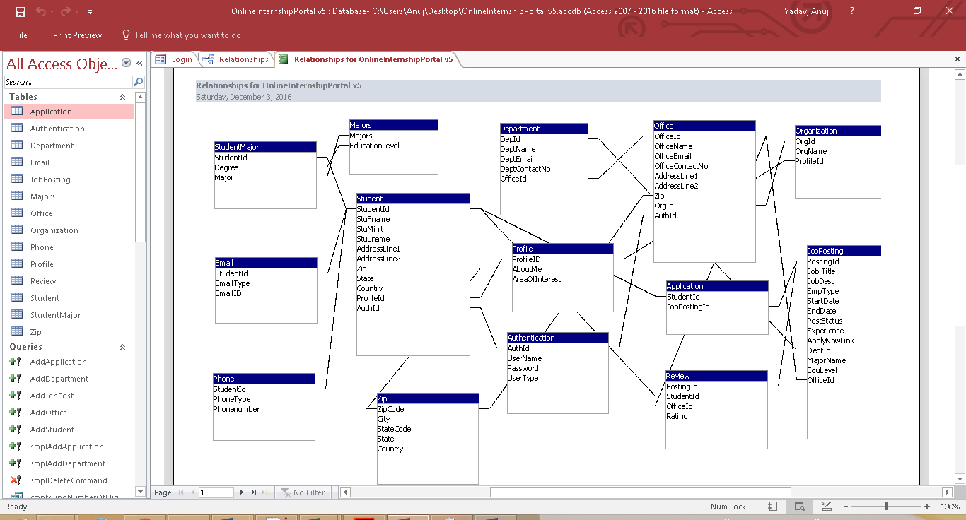
SCHEMA and relationship in SQL implementation

Slide 4





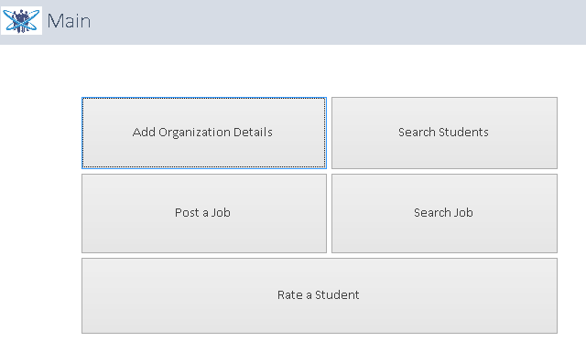
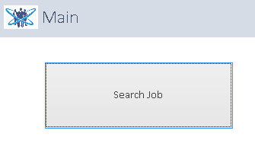
Login functionality for different users

Slide 5
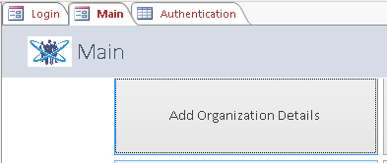
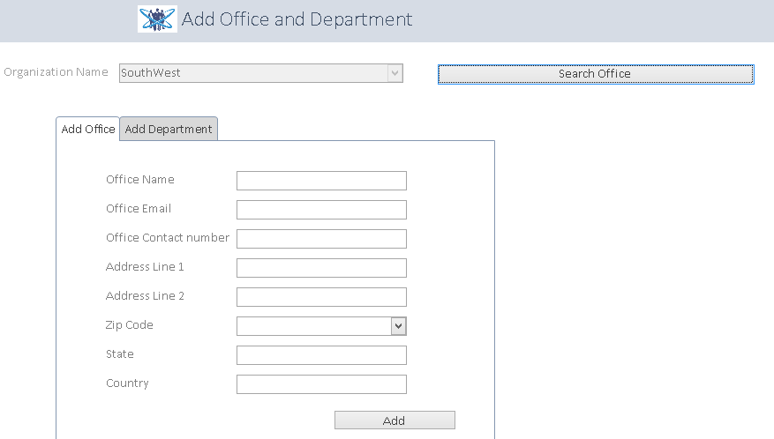
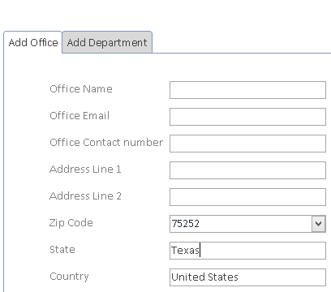
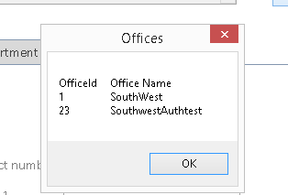
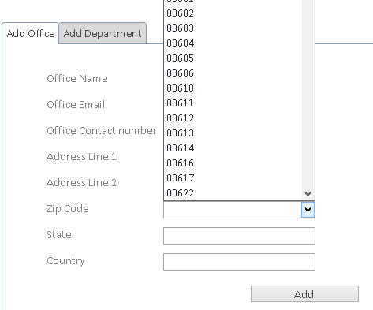


Queries in action - Add Organization Details
These are populated from parameterized query

Slide 6

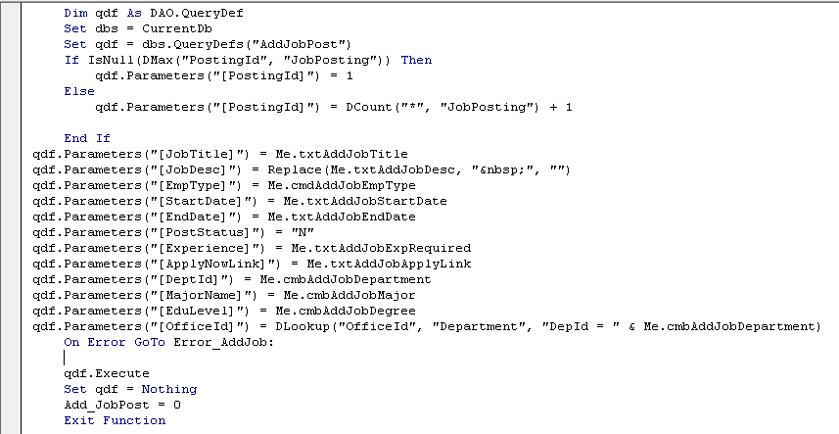
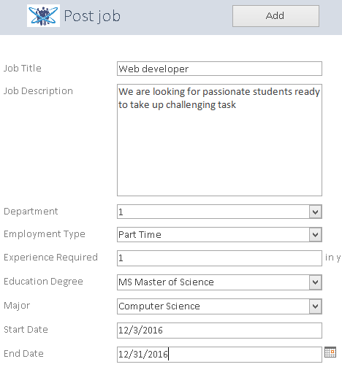
Queries in action – Post Job

Slide 7





Queries in action – Search Job

Slide 8


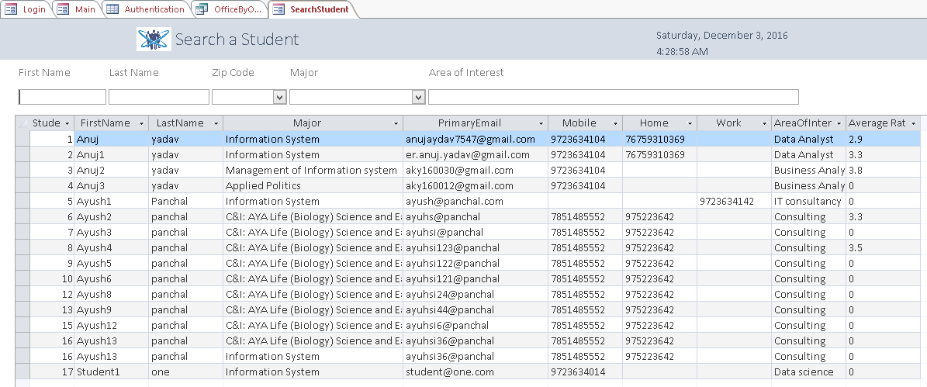
Queries in action – Search Student

Slide 9

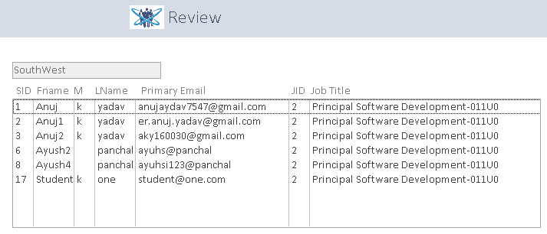


Queries in action – Rate a student
A student will be reviewed based on the job they worked upon

Slide 10
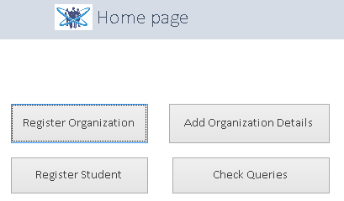

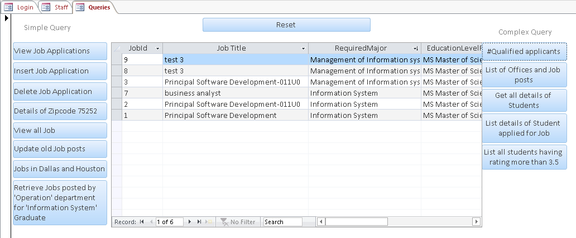
More features – Query Dashboard
What about administration?

